Slide 1

Create Advance Database Objects

Slide 2
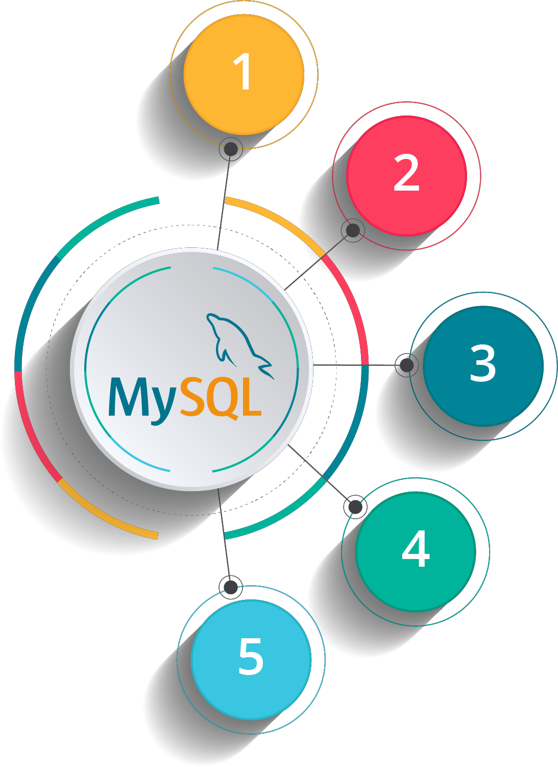

Course Outline
DDL (Data Definitions Language) Commands
DML (Data Manipulation Language) Commands
Retrieve Data from Multiple Tables
Inbuilt Functions in SQL
Create Advance Database Objects

Slide 3


Create Advance Database Objects

Slide 4
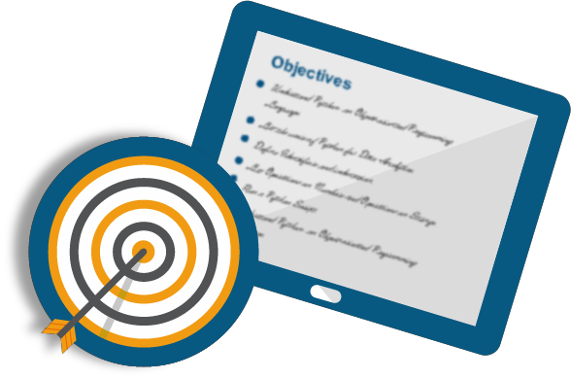
Objectives
After completing this module, you should be able to:
Create Stored Procedure
Execute Stored Procedure
Create Functions
Create Triggers

Slide 5
Stored Procedure
A stored procedure is a set of sql statements with a name, that has been created and stored in the database
Stored Procedure can be defined as the set of logical group of SQL statements which are grouped to perform a specific task
Like other programming constructs they can:
Accept input parameters
Return multiple values (out parameters)
Contain programming statements
Can call other stored procedures/functions
Returns status to indicate success or failure

Slide 6







Stored Procedure: Syntax
Syntax:
CREATE [OR ALTER] PROCEDURE
schema_name.procedure_name ( @parameter_name AS parameter_data_type [OUT])
AS BEGIN
<SQL STATEMENTS/COMPUTATION>
END;
Note: Use ALTER instead of CREATE to make changes in the procedure

Slide 7
Stored Procedure: Benefits
Reduced sever/client network traffic
All commands in a procedure are executed as a single batch of code
Stronger security
The EXECUTE AS can be specified to enable impersonating another user to perform certain db tasks without providing direct
permission to the procedure
Reuse of code
The code (procedure) can be called from other procedures
Easier maintenance
Changes need to be done within stored procedure which handles all db operations and no changes are required in client
applications
Improved performance
All procedures by default are compiled in the database the first time it is executed and maintains the execution plan for
subsequent calls

Slide 8
Stored Procedure: Example
Create AS BEGIN
PROCEDURE sp_GetEmployeeInfo(@empid INT)
Execute:
USE [empDB] GO
SELECT[emp_id]
,[first_name]
,[last_name]
,[mgr_id]
,[phone_number]
,[hire_date]
,[job_id]
,[deptno]
FROM [empDB].[dbo].[employee] WHERE emp_id = @empid
END;
DECLARE @return_value int
EXEC @return_value = [dbo].[GetEmployeeInfo]
@empid = 1001
SELECT 'Return Value' = @return_value

Slide 9


User Defined Functions (UDF)
Like functions in programming languages, User Defined Functions are compact pieces of Transact SQL code, which can accept parameters, perform complex calculation and return either a value, or a table
Scalar Valued Function
A scalar value function is used to return the single value only like Integers or may be timestamp
Table Valued Function
A table valued function is used for any number of the row set values. It is useful in the case of the returning multiple rows set at the same time
All procedures by default are compiled in the database the first time it is executed and maintains the execution plan for subsequent calls

Slide 10

UDF: Scalar Function
Scalar functions return a single data value of the type defined in the RETURNS clause
No function body is required for an inline Scalar function
When multi statements need to be provided within BEGIN-END block
Syntax:
CREATE [OR ALTER] FUNCTION schema_name. function_name(@parameter_name AS parameter_data_type) RETURNS return_data_type
AS BEGIN
<SQL STATEMENTS/COMPUTATION>
RETURN scalar_value;
END;

Slide 11
Scalar Function: Example
CREATE FUNCTION fn_getdeptno(@empid INT) RETURNS INT
BEGIN
RETURN (SELECT DEPTNO FROM EMPLOYEE
WHERE EMP_ID = @empid)
END
Execute:
USE [empDB] GO
select * from employee
where deptno = dbo.fn_getdeptno(1001);

Slide 12
UDF: Inline Table-Valued Function
Inline table valued functions are a subset of user-defined functions that return a table data type Inline functions can be used to achieve the functionality of parameterized views
Inline table valued functions can be used to support parameters in the search conditions specified in the WHERE clause
Inline user-defined functions follow these rules:
The RETURNS clause contains only the keyword table. Format need not be defined for return value
There is no function_body delimited by BEGIN and END.
The RETURN clause contains a single SELECT statement in parentheses.
The table-valued function accepts only constants or @local_variable arguments
CREATE [OR ALTER] FUNCTION schema_name.function_name (@parameter_name RETURNS TABLE
AS
BEGIN
RETURN <SQL STATEMENTS>; END;
AS parameter_data_type )

Slide 13
Inline Table-Valued Function: Example
CREATE FUNCTION fn_GetEmployeeInfo (@empid
int)
RETURNS TABLE AS
RETURN (
SELECT[emp_id]
,[first_name]
,[last_name]
,[mgr_id]
,[phone_number]
,[hire_date]
,[job_id]
,[deptno]
FROM [empDB].[dbo].[employee] WHERE emp_id = @empid
);
Execute: USE [empDB] GO
select * from
fn_GetEmployeeInfo(1001)
GO

Slide 14
UDF- Multi-Statement Table: Valued Function
User-defined functions that return a table data type can be powerful alternatives to views
A table-valued user-defined function can be used where table or view expressions are allowed in Transact-SQL queries views are limited to a single SELECT statement, user-defined functions can contain additional statements
In a table-valued user-defined function:
The RETURNS clause defines the format of the table. The scope of the local return variable name is local within the function
The Transact-SQL statements in the function body build and insert rows into the return variable defined by the RETURNS clause
The rows inserted into the variable are returned as the tabular output of the function
CREATE [OR ALTER] FUNCTION schema_name. function_name ( @parameter_name AS parameter_data_type ) RETURNS @return_variable TABLE <table_type_definition>
AS BEGIN
<SQL STATEMENTS/COMPUTATION>
RETURN;
END;

Slide 15
Multi-Statement Table-Valued Function: Example
CREATE FUNCTION fn_GetEmployeeInfo(@DeptID INTEGER)
RETURNS @retGetEmployeeInfo TABLE (
EmployeeID int primary key NOT NULL, FirstName nvarchar(255) NOT NULL, LastName nvarchar(255) NOT NULL, Deptno INT NOT NULL
) AS
BEGIN
INSERT @retGetEmployeeInfo SELECT [emp_id]
,[first_name]
,[last_name]
,[deptno]
FROM [empDB].[dbo].[employee] WHERE deptno = @DeptID
RETURN END; GO
Execute:
USE [empDB] GO
SELECT EmployeeID, FirstName, LastName,
Deptno
FROM fn_GetEmployeeInfo(10);

Slide 16
User Defined Functions (UDF): Benefits
Modular Programming
Functions are stored in db and can be call any number of times in your program
Faster Execution
Like stored procedures, all functions are compiled in the database and maintains the execution plan for subsequent calls
Reduce network traffic
A complex constraint that cannot be expressed as a single scalar expression can be written in a function and can be invoked from WHERE clause

Slide 17

Triggers
A trigger is a special kind of stored procedure that automatically executes when an event occurs in the database server. DML triggers execute when a user tries to modify data through a data manipulation language (DML) event. DML events are INSERT, UPDATE, or DELETE statements on a table or view
Syntax:
CREATE [ OR ALTER ] TRIGGER schema_name.trigger_name ON {
table | view }
FOR | AFTER | INSTEAD OF
[ INSERT ] [ , ] [ UPDATE ] [ , ] [ DELETE ] AS
sql_statement;

Slide 18
Triggers: Benefits
Following are the benefits of triggers:
Provides alternative method for implementing referential integrity constraint
Restricts/Controls updates on the database objects
can be used to publish information about database events (startup & shutdown) to subscribers

Slide 19
Trigger: Example
CREATE TRIGGER trg_employee ON employee
AFTER INSERT
AS BEGIN
-- SET NOCOUNT ON added to prevent extra
result sets from
-- interfering with SELECT statements.
SET NOCOUNT ON;
-- Insert statements for trigger here INSERT INTO [employeeaudit](
[emp_id]
,[first_name]
,[last_name]
,[mgr_id]
,[phone_number]
,[hire_date]
,[job_id]
,[deptno]
,machinename
,serverName
,[InsertTime])
-- continue….
-- …. Continued….
SELECT [emp_id]
,[first_name]
,[last_name]
,[mgr_id]
,[phone_number]
,[hire_date]
,[job_id]
,[deptno]
,CAST( SERVERPROPERTY('MachineName') AS VARCHAR(50))
,CAST( SERVERPROPERTY('ServerName') AS VARCHAR(50))
,GETDATE() FROM INSERTED;
END GO

Slide 20
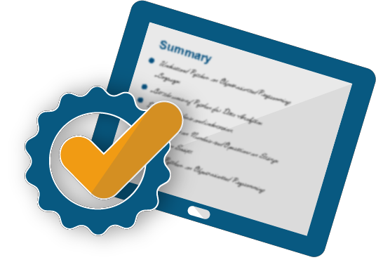
Summary
In this module, you should have learnt to:
Create Stored Procedure
Execute Stored Procedure
Create Functions
Create Triggers

Slide 21




Slide 22


Slide 23


